Slide 1


Pet Adoption and Rescue Management Portal
"Saving one animal won't change the world, but it will change the world for that one animal."
A comprehensive pet rescue and adoption management portal connecting hearts and homes.

Slide 2
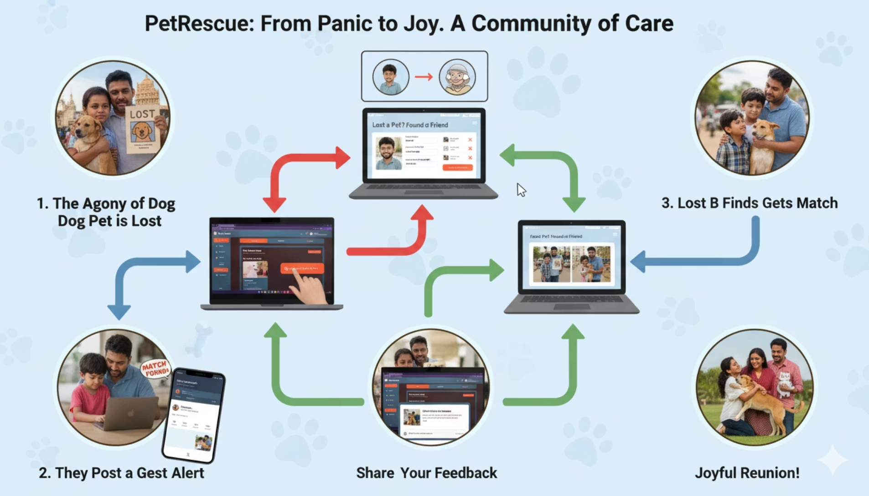
Project Objective
Pet Adoption and Rescue Management Portal’s core objective is to revolutionize pet rescue and adoption by creating a streamlined platform that connects animals in need with loving families, ensuring every pet finds its forever home.
Seamless Pet Rescue & Adoption
Facilitating easy connections between rescue organizations, potential adopters and pets through a unified, user-friendly interface.
Efficient Process Management
Automating critical workflows from application submissions to medical record tracking, reducing administrative burden and accelerating adoptions.

Slide 3









Technology Stack
Frontend Technologies
Backend Technologies
React
Django REST
Dynamic, responsive UI
Scalable API architecture
TypeScript
Python
Robust, maintainable code
Server logic, algorithms
Tailwind CSS
JWT Authentication
Mobile-first, consistent styling
Secure user sessions
Vite
PostgreSQL
Fast build tool, rapid development
Reliable database management

Slide 4
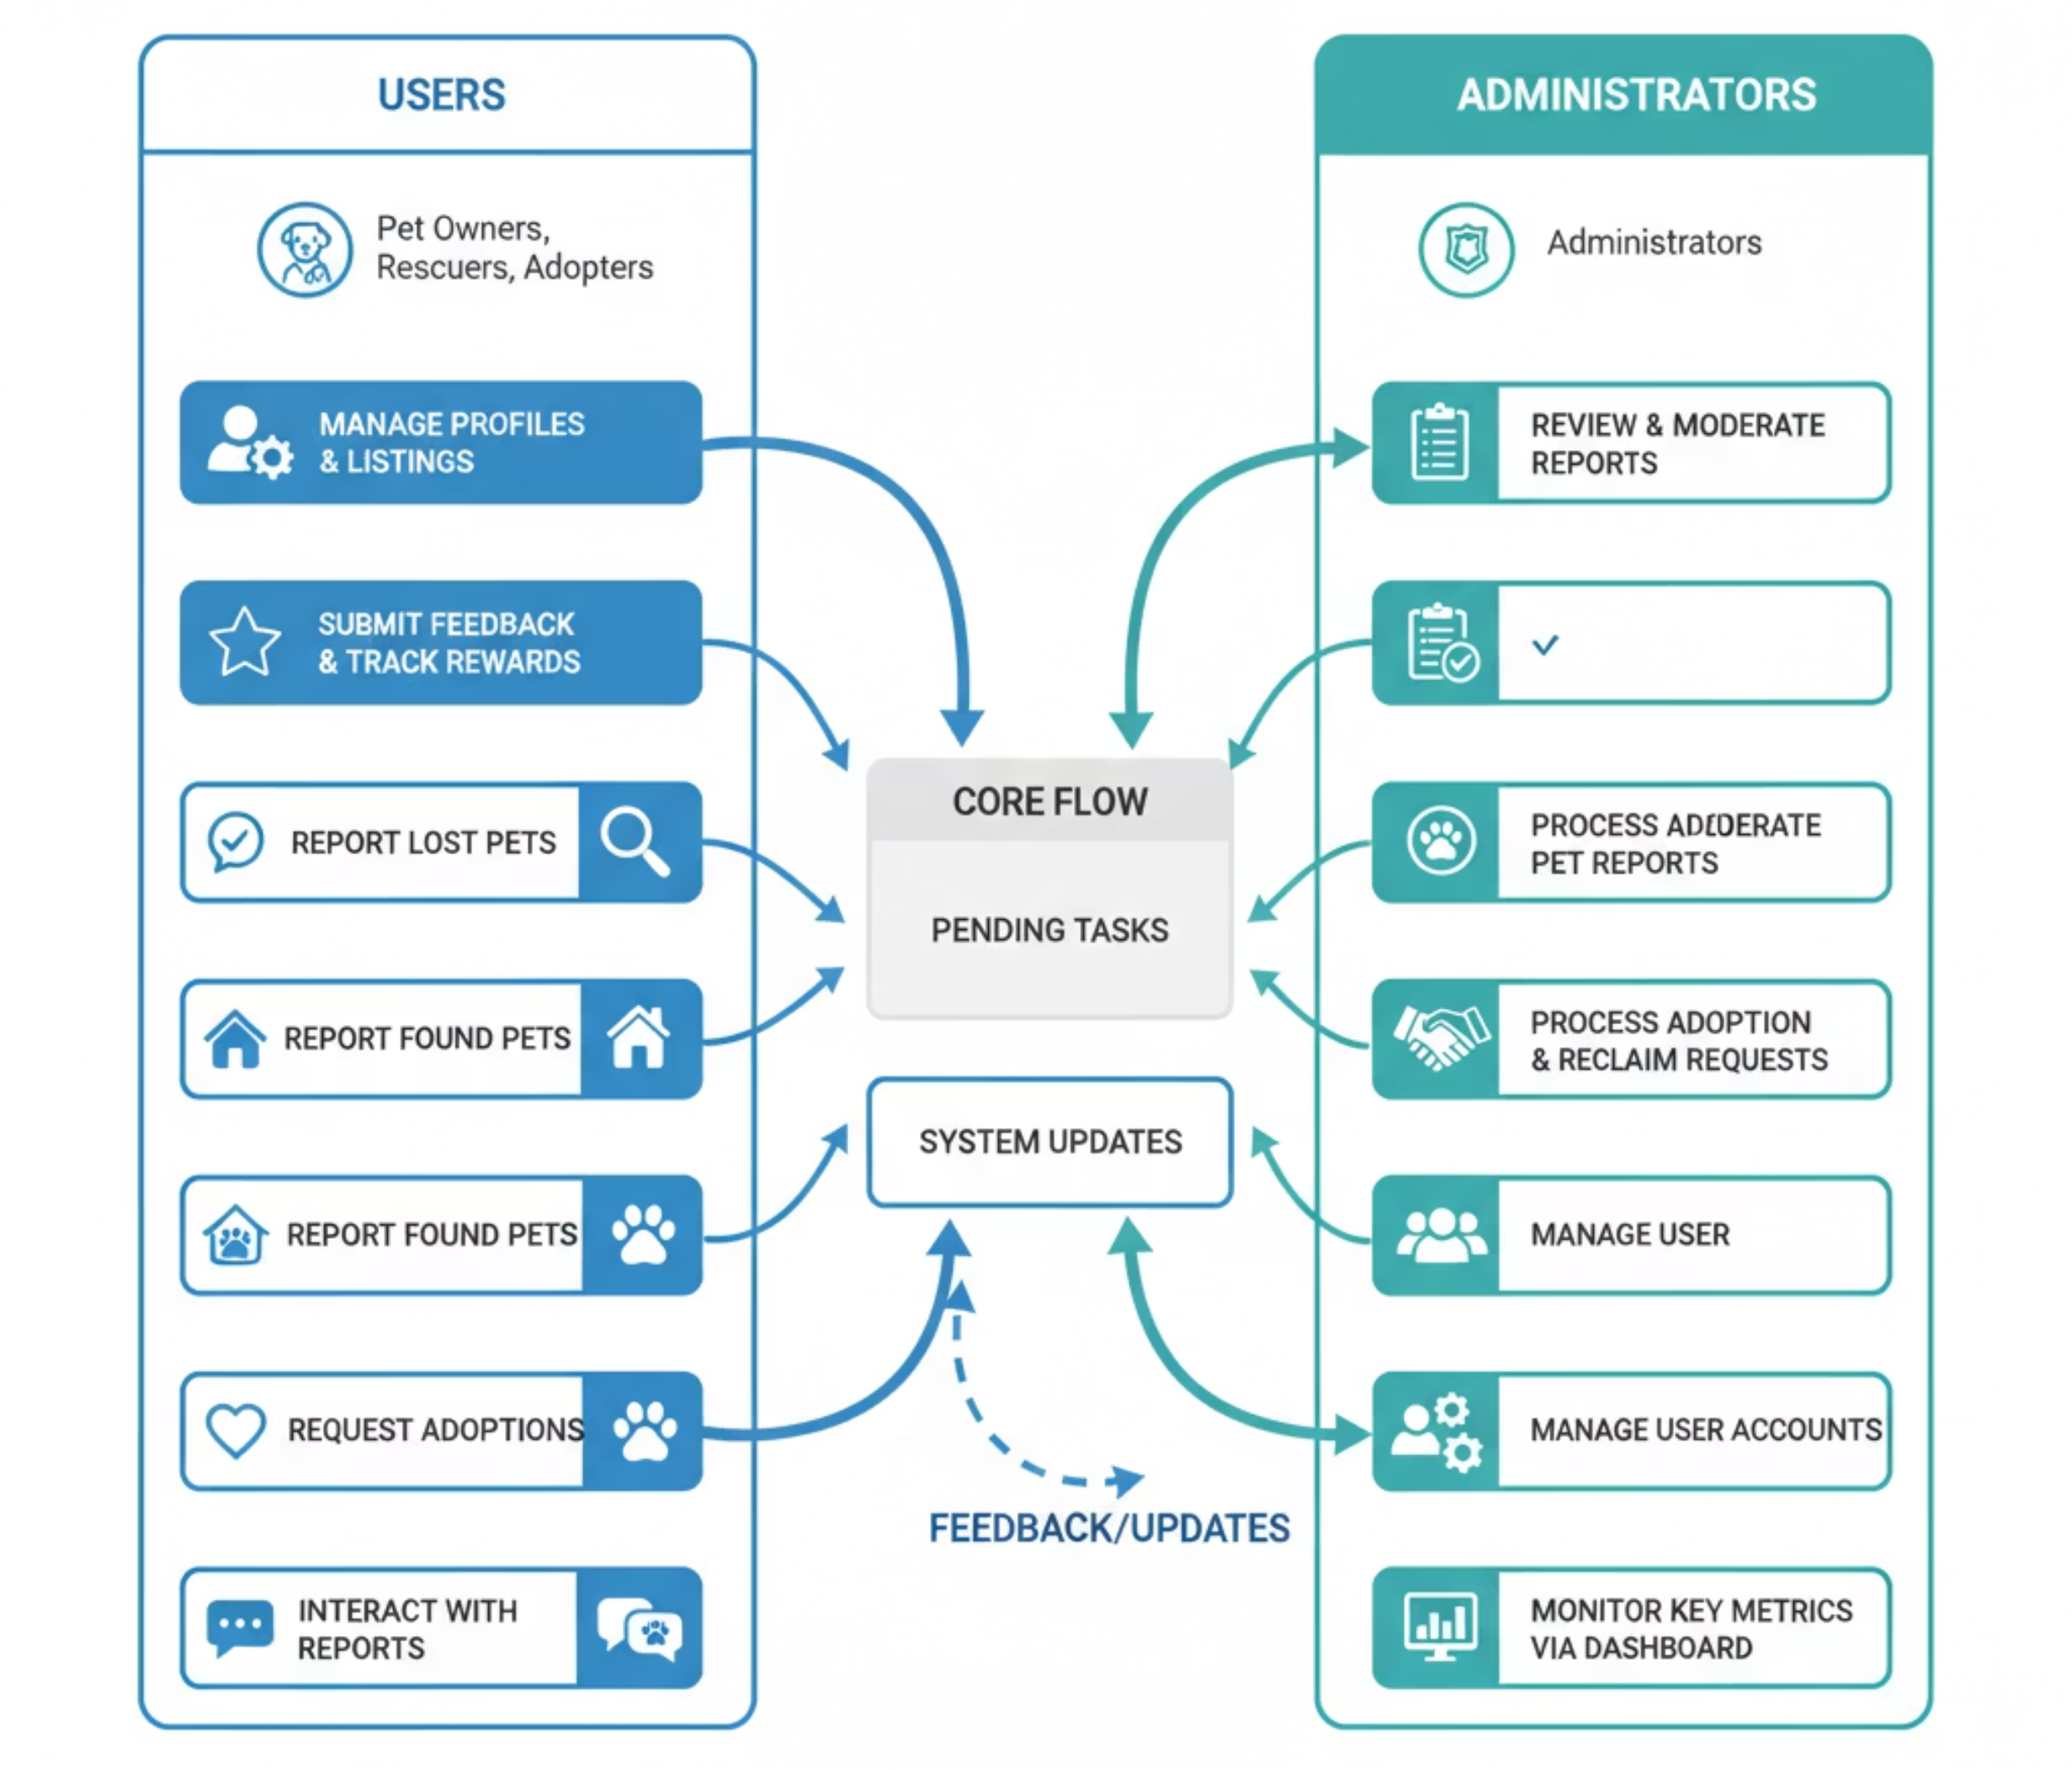
MANAGE PROFILES
APPROVE/REJECT RESCUE REPORTS
App Flow
PROCESS LOST PET REPORTS
"From profiles to reunions, Pet Adoption And Management Portal streamlines every step — connecting pets, families, and administrators in a seamless loop of care, action, and accountability."
Check recent pets
GENERATE ANALYTICS

Slide 5






Future Enhancements
AI Pet Recognition
Advanced facial recognition specifically trained on pets to automatically match found animals with missing reports.
Automated Background Verification System
Streamlined background checks for potential adopters to ensure pet safety and accelerate the adoption process.
Virtual Meet & Greet
Video conferencing integration allowing remote pet interactions, virtual home visits, and online adoption counselling sessions.
Donation Portal
Integrated fundraising platform to support shelters and rescue organisations with secure payment processing and transparent fund allocation.
Vet & Shelter Partnerships
Integrated network connecting local veterinary clinics, animal shelters, and rescue organisations for comprehensive care resources.

Slide 6


Thank You
Questions & Discussion
Together, we're building technology that saves lives and creates lasting bonds between pets and families.
Pet Adoption and Rescue Management Portal: Where every pet finds their perfect match, and every family discovers unconditional love.

